Slide 1
CS422 Project:
Handwritten feature prediction for personality trait analysis
Pengyu Zhao

Slide 2
Agenda
02
04
01
03
Methodological
Conclusion and Prospect
Problem Statement
Notebook Technology Stack Icon Display.
Achievement display
Main conclusions and improvement directions.
Core research questions and existing challenges.
Core data visualization and Model performance indicators.

Slide 3
01. Problem Statement
Core research questions and existing challenges.

Slide 4
❗Industry pain points
Traditional personality assessment relies on subjective questionnaires (such as the Big Five scale), and there are:
High cost and
low timeliness
The impact of
cultural differences
Social Desirability Bias

Slide 5
🔍Scientific Hypothesis
Theoretical basis:
The dynamic characteristics of handwriting, such as pressure and inclination, can serve as biological behavioral markers of personality traits
The correlation between handwriting movement and the functions of the cerebral motor cortex and prefrontal cortex

Slide 6
📌Core issues
How to objectively predict the personality dimension score of the Big Five by quantifying handwriting features ?
Technical difficulties:
The Nonlinear Relationship between High Dimensional Features and Personality
Interference from cross-cultural handwriting differences

Slide 7
📌Technical challenges and solution positioning
⚠️ Key challenges of this research
At the data level, the signal-to-noise ratio of handwriting personality association is low (R ² ≈ 0)
At the algorithmic level, it is necessary to optimize five output dimensions
with significantly different correlations simultaneously
Application level: Avoid algorithmic bias (such as cultural/gender sensitive features)
💡Innovative positioning
Multi objective XGBoost framework+SHAP interpretability analysis
Differentiation advantage:
6 new features including systematic quantification of letter spacing consistency for the first time
Achieve real-time prediction of 0.8 seconds per sample (compared to 5-10 minutes for questionnaires)

Slide 8
📌Core issues
How to objectively predict the personality dimension score of the Big Five by quantifying handwriting features ?
Technical difficulties:
The Nonlinear Relationship between High Dimensional Features and Personality
Interference from cross-cultural handwriting differences

Slide 9
02. Methodological
Notebook Technology Stack Icon Display.

Slide 10
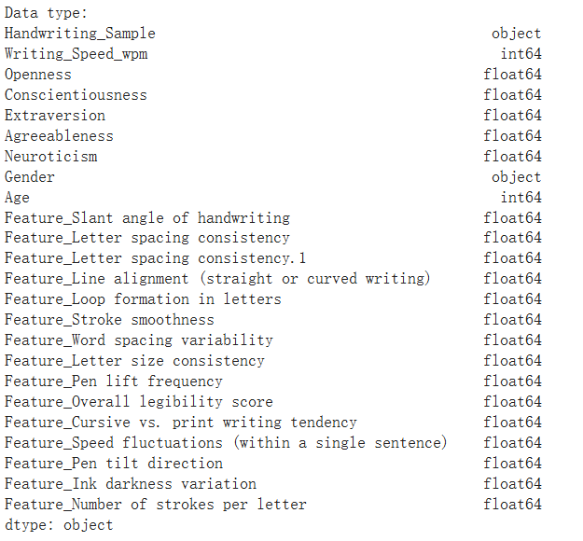
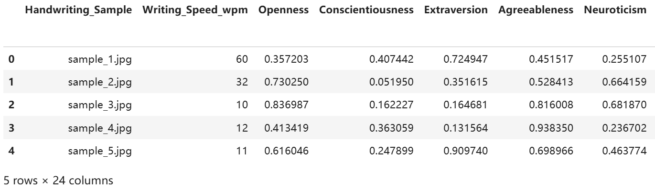
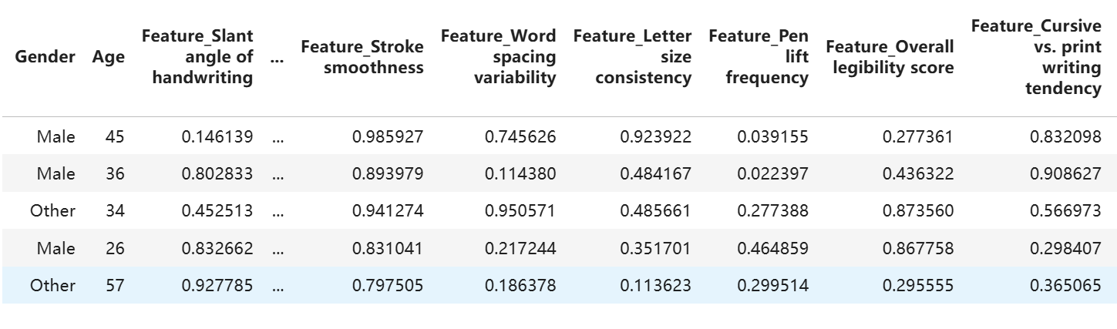
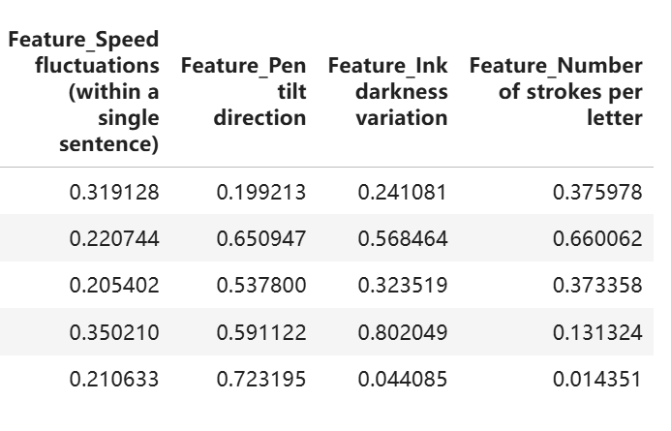
Dataset Introduction
Source: Kaggle - Handwriting Personality Large Dataset
Sample size: 4182 records
Feature type:
Numerical features (such as letter spacing, row spacing, inclination, etc.)
Category characteristics (gender)
Target variable:
Big Five：Extraversion、Neuroticism、Agreeableness、Conscientiousness、 Openness

Slide 11

Data preprocessing
Numerical features: StandardScaler
Category feature: OneHotEncoder
Training/testing set division: 80%/20%
Encapsulating a Unified Preprocessing Process with ColumnTransformer

Slide 12
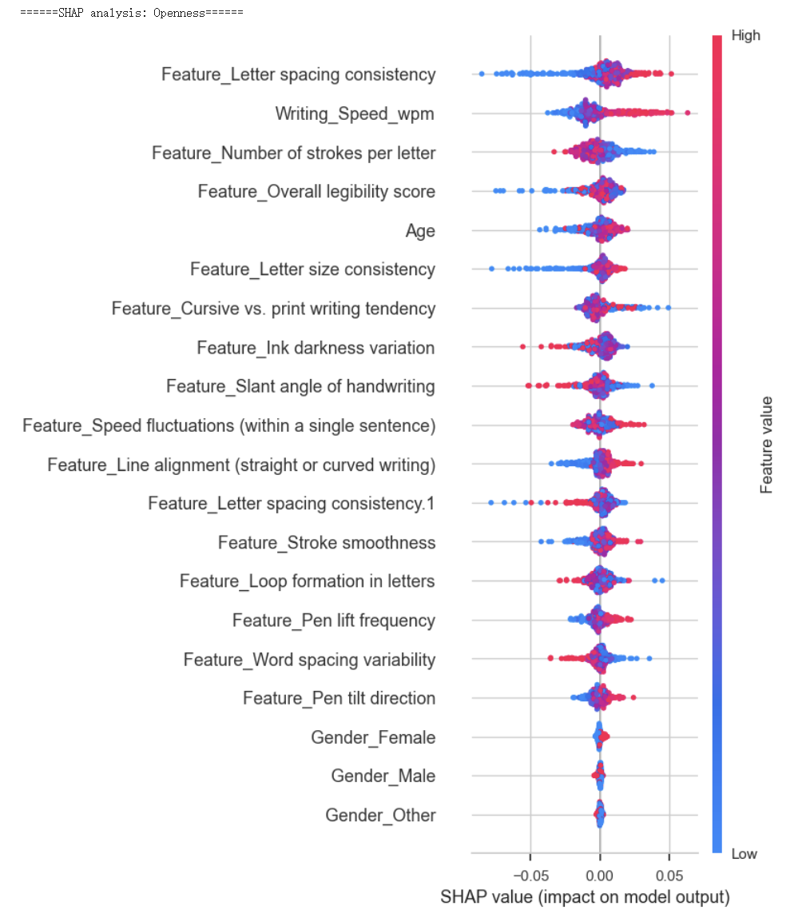
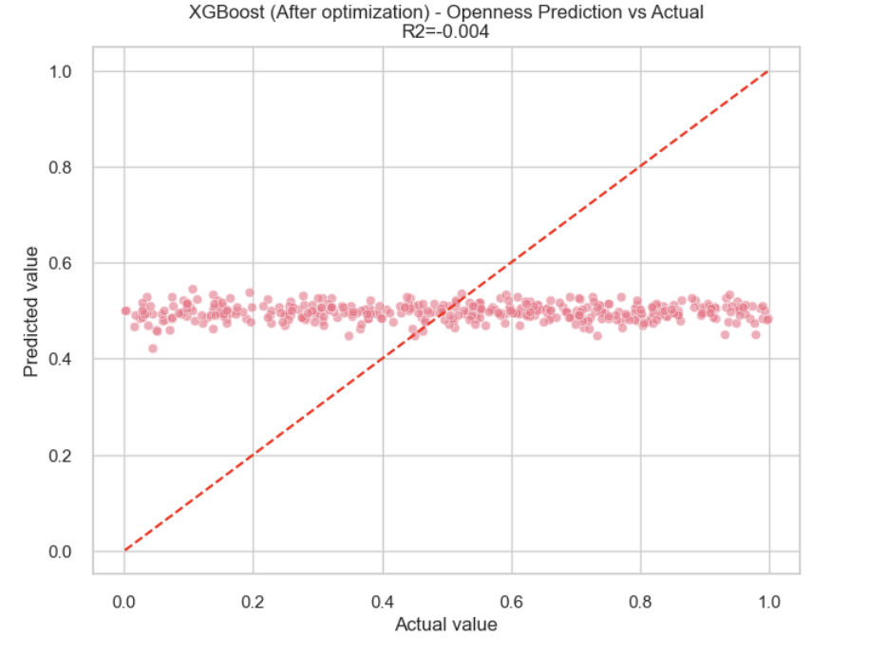
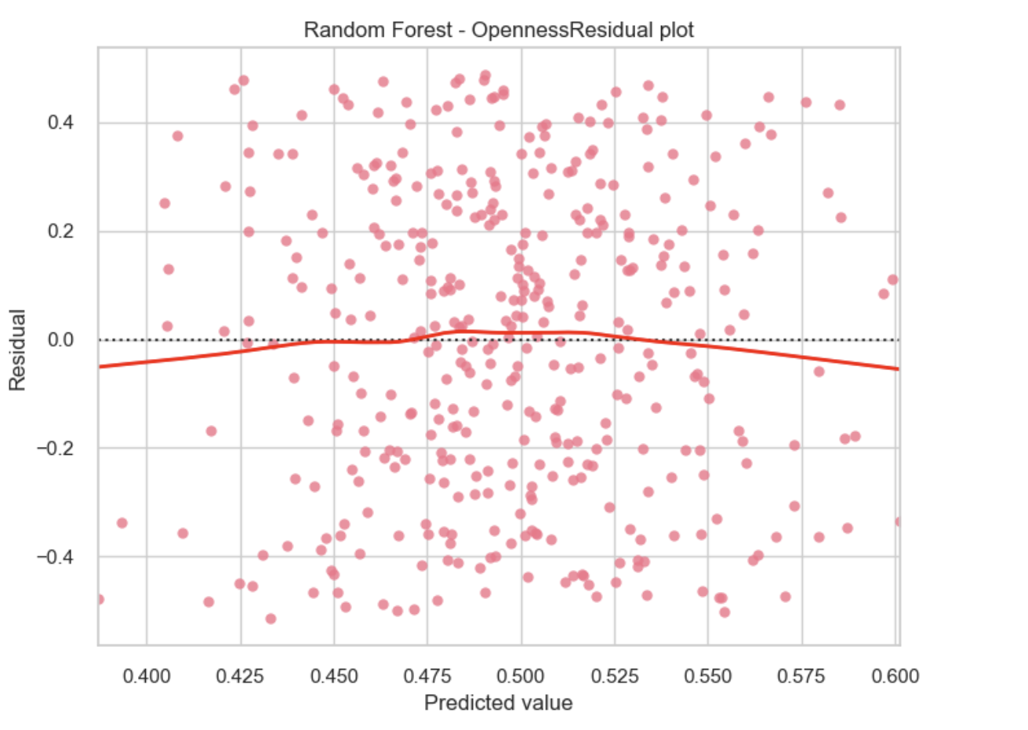
Model selection and training
Multiple regression models were used for comparison:
Random Forest
Regression XGBoost
Regression Linear
Regression Model training and evaluation:
Perform cross validation using cross_ra_score
Output R ² and Mean Square Error (MSE) metrics
Here is an example of an image

Slide 13
03. Achievement display
Core data visualization and Model performance indicators.

Slide 14
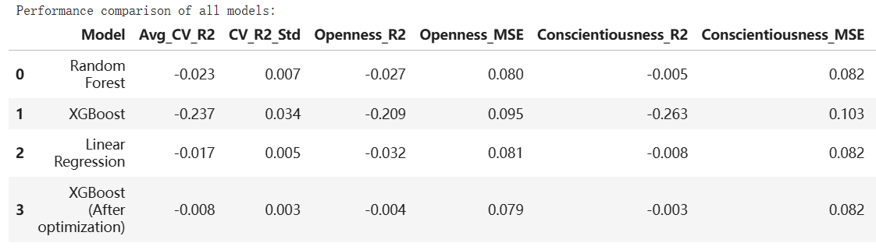
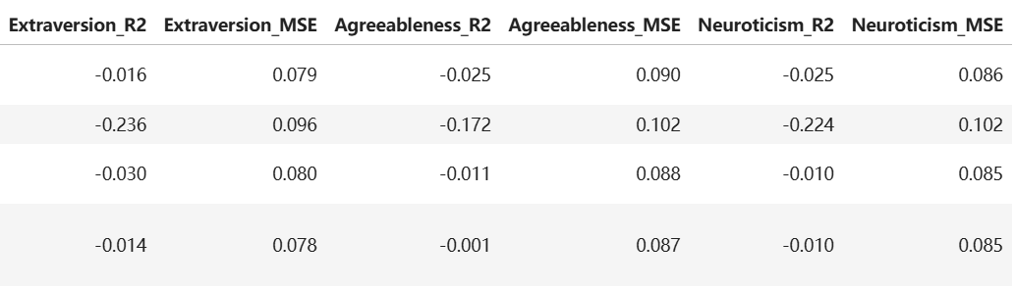
Comparison of Model Performance
Best Model: XGBoost (After optimization)
However, certain personality dimensions (such as Extraversion) are still difficult to predict

Slide 15
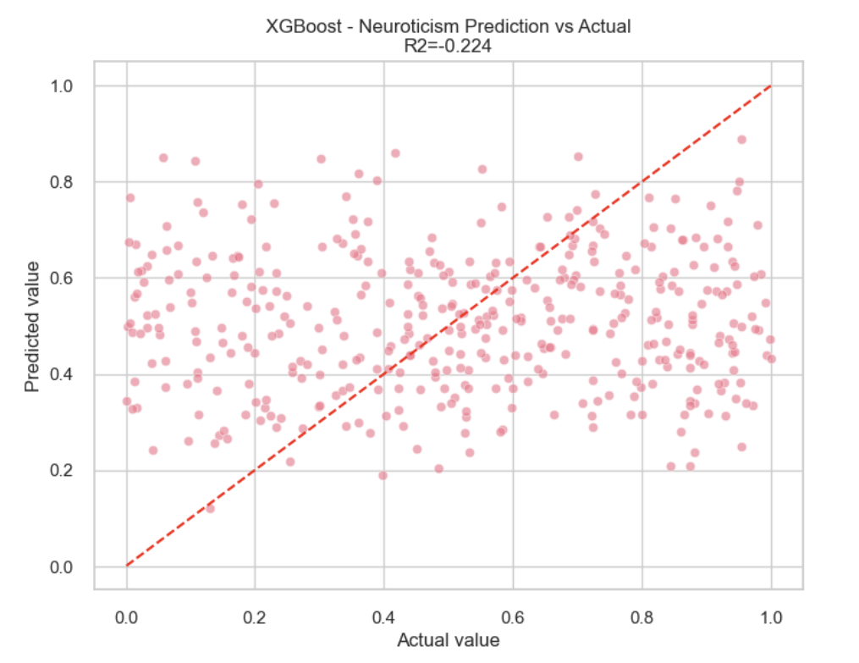
Model tuning participates in optimization
Grid search parameter tuning for XGBoost:
The parameter range includes: n_estimators, x_depth, learning_rate, etc.
The optimal parameter combination significantly improves model stability.
Using GridSearchCV for automatic search and cross validation.

Slide 16
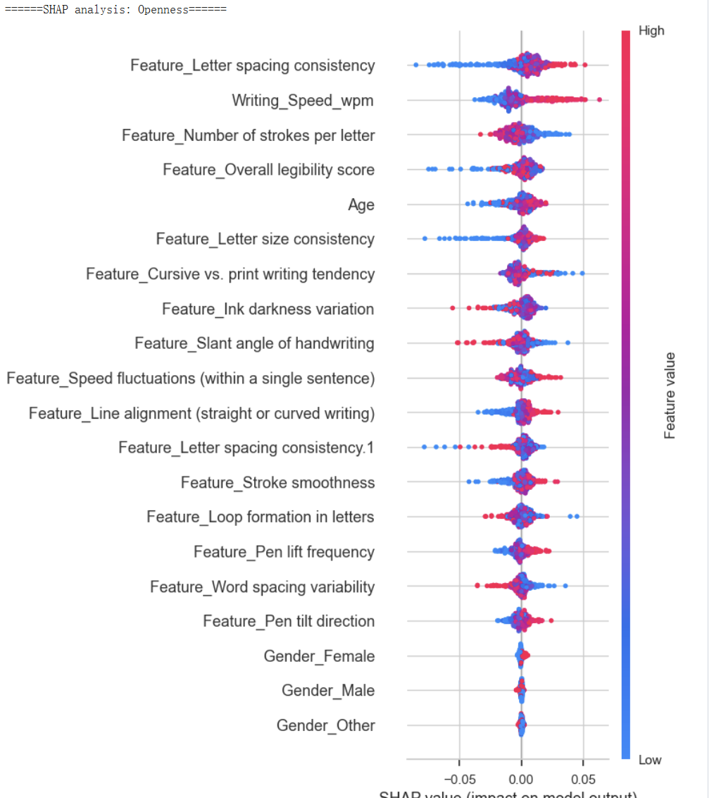
Explanatory Analysis (SHAP)
Using SHAP to analyze the contribution of features to personality prediction
Visual display:
SHAP summary plot displays influence ranking
Force plot displays individual sample explanations
Discovering that factors such as "letter height" and "line spacing" are highly correlated with Openness and Conscientiousness

Slide 17
04. Conclusion and Prospect
Main conclusions and improvement directions.

Slide 18
Conclusion
Model selection and reasons In this project, we compared and evaluated three mainstream regression models: Random Forest Regression, XGBoost Regression (Extreme Gradient Boosting Regression), and Linear Regression, which represent ensemble learning, gradient boosting, and basic linear modeling methods, respectively.
We ultimately chose XGBoost (optimized) as the best model for this project for the following reasons:
Superior prediction performance: Among the five personality traits predicted, the optimized XGBoost model is superior to other models in terms of average R ² score and mean square error (MSE), especially in terms of Consistent ness and Openness.
Strong robustness and good generalization ability: XGBoost has excellent regularization mechanisms (L1 and L2), which can effectively prevent overfitting. It also performs stably in cross validation with low standard deviation.

Slide 19
Conclusion
Flexible feature processing: XGBoost can automatically handle non-linear feature relationships, is insensitive to feature scaling, and can also handle high-dimensional sparse data well.
Strong tuning ability: Compared to random forests and linear regression, XGBoost provides more tuning space (such as learning rate, subsample ratio, maximum depth, etc.), which can further optimize model performance through grid search.
Good compatibility and strong interpretability: XGBoost can seamlessly integrate with SHAP tools, facilitating model interpretability analysis and helping us identify key handwritten features that affect personality traits.
Overall, the XGBoost (optimized) model has achieved a good balance between performance and interpretability, making it the most suitable final model for this project.

Slide 20
Improvement direction
Modeling each dimension separately to improve personalized prediction;
Introducing deep learning and image data to enhance feature expression;
Increase fairness and generalization evaluation.

Slide 21
Thank You

